Slide 1

Course: 100
Payment Systems Overview
April 11, 2014
Version 3.0

Slide 2
Getting Started
Pre-requisite: None Duration: 2 Hrs
Audience: New Appointees Domain Credit: 0.5
Agenda:
- What do you don’t see but sign - Settlement Cycle
- Relationship Model - Types of Cards
- Authorization Cycle - Co Branded Cards
- Risk Transference Model - Risk and Fraud Management
- Recapitulation - Reliability and High Availability
- What is Transaction Quality - Dispute Management System
Interchange Rules - Data Analytics

Slide 3
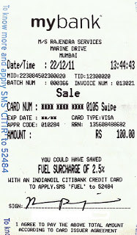
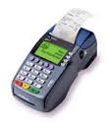
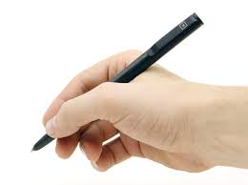
What you PROBABLY DO SEE before signing
Amount
Promo
Offers
Signature
---------------------------------------
Notes:
I am assuming all have used some form of payment cards for purchasing goods or services
We are presented with such slip at point of sale. What we generally do is look at the amount and sign on the slip.
There are so many things written which we do not read but accept by signing on the dotted lines

Slide 4
What you DON’T SEE but sign ☺
Acquiring Bank
Merchant Address
Transaction Date
Transaction Time
Merchant ID
Terminal ID
Batch Number
Invoice Number
Card Number
Mode
Card Expiry Date
Card Type
Approval Code
RRN : Reference Num
Your Signature
Signature
Amount
---------------------------------------
Notes:
Now you see so many information elements are there which we do not read
This session is more about these data elements and some thing more

Slide 5

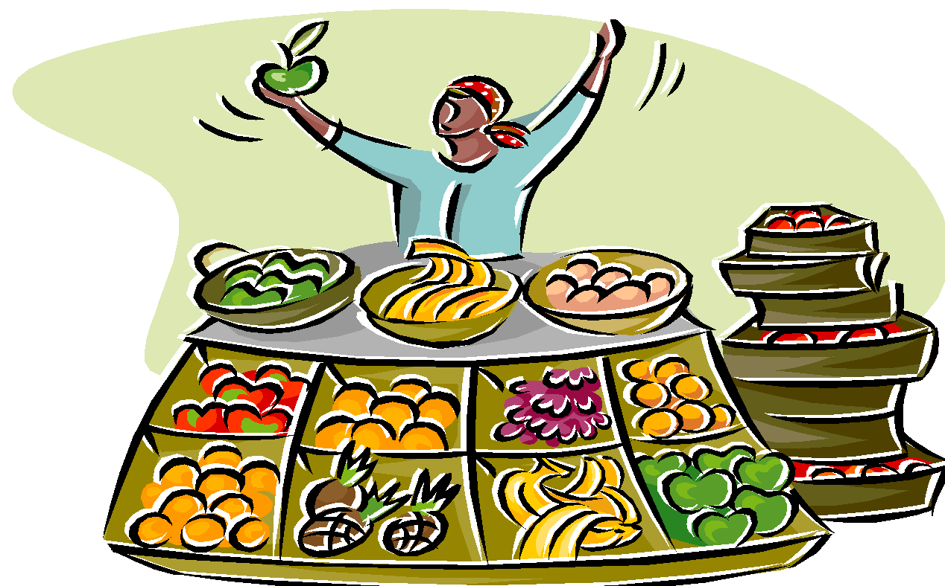
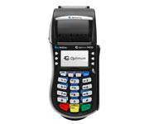
Relationship Model – Chain of Trust
VALUE EXCHANGE
Notes:
When a customer visits a store to purchase, it is highly likely that customer and merchant do not know each other and hence there is no element of trust that can be formed.
So, how does the value exchange happens in absence of trust

Slide 6


Relationship Model – Chain of Trust
My Card
We Accept
VALUE EXCHANGE
Notes:
It happens through the brand promise of the payment network brands – one is with the card holder and the other is with the merchant.

Slide 7



Relationship Model – Chain of Trust
Payment Network
Card Issuing
Merchant Acquiring
My Card
We Accept
VALUE EXCHANGE
It is about BRAND PROMISE of networks that enables the value exchange
Notes:
And behind them is the chain of trust built through relationships
Cardholder has relation with the Issuer Bank, Merchant has relation with the Acquiring Bank, and these Banks have relation with the Payment Networks – which completes the chain of trust cycle

Slide 8
Authorization Cycle
Payment Network
Card Issuing
Merchant Acquiring
Routes to Acquirer
Routes to Merchant
Routes to Issuer
Routes to Network
My Card
We Accept
Issuer evaluates
Sends approve/reject
Routes to Terminal
Routes to Acquirer
Open To Buy
Open To Buy
Presents the card
Swipes
Print Slip
Black are REQUEST, Red are RESPONSE
Notes:
What is Authorization? It is about an electronic verification that cardholder has the ability to pay for the goods she is purchasing and this verification is made available to the merchant in form of an Approval Code coming all the way from the Card Issuer.
Now lets see the flow
Note that as the Issuer authorized the amount the available fund or the “open to buy” amount is deducted by the authorized amount
In case of credit cards this is reduced from the line of credit and for debit card this amount is removed from the savings account and parked in an escrow account waiting to be paid in the settlement cycle

Slide 9
Back to the slip you sign …
BIN: 412345
Payment Network
Card Issuing
Merchant Acquiring
4
Acquiring Bank
12345
Date, Time, RRN
My Card
We Accept
Approver Code
Merchant ID
Card Number
Expiry Date
Card Type
Mode
Invoice #
Batch #
Terminal ID
Black are static for a network, Red are dynamic during a transaction
Notes:
During the authorization cycle we get to all the data elements that we see in the slip
Some of these are static in nature (black) and some are dynamic (red)
When you present the card merchant tries to SWIPE it but if it fails he may KEY IN the card number – This variation is captured in MODE
To tie in the list of items purchased and detailed break up of costs – which is typically called INVOICE - with the payment, there is a field called INVOICE #
All the transactions are logged in a electronic file within the POS called BATCH. Each Batch File has a number called BATCH #. At the end of day or end of shift, the batch files are “closed”, i.e. tallied with the actual slips obtained during the day and merchant makes sure all the totals tally. Once they are satisfied, they submit it to the Acquiring Processor as a “claim for their money”, which in turn triggers the settlement cycle.
In order to identify each of the millions of transactions uniquely, Payment Networks stamps it with Date, Time and a Reference Number (RRN). Issuer stamps it with Approval Code which Issuers use to tally settlement claims during settlement cycle.
The rest of the data elements are static like card number, expiry date, terminal id, etc
The payment network is identified by the first digit of the card number “4” for Visa, “5” for MasterCard, etc

Slide 10
What you DON’T SEE but sign ☺
Acquiring Bank
Merchant Address
Transaction Date
Transaction Time
Merchant ID
Terminal ID
Batch Number
Invoice Number
Card Number
Mode
Card Expiry Date
Card Type
Approval Code
RRN : Reference Num
Your Signature
Signature
Amount
---------------------------------------
Notes:
Now you see so many information elements are there which we do not read
This session is more about these data elements and some thing more

Slide 11
Risk Transference Model
SETTLEMENT HAPPENS
Card Issuing
Merchant Acquiring
Send Clearing Stmt
Send Clearing Stmt
Sends Claims
Sends Claims
Send Stmt
Risk
Get Paid
½ day
40 days
Risk
Makes Payment
Send Batch File
Risk
1 day
You present card
Merchant provides slip
You sign the slip
Merchant provides goods/svc
Risk
1 day
Notes:
The electronic payment runs on risk transference model
When Merchant provides the goods/services to customer in lieu of a signed slip, the risk is on merchant
When merchant claims the money from acquirer via the “batch files” and gets paid, the risk is on acquirer
When network pays to acquirer but waits for money to flow in from issuers, the risk is with network
When the issuer pays the network and waits for card holder to pay the risk is with issuer

Slide 12
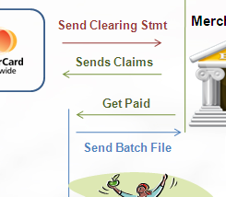
What if …
Authorization happens but Batch Close file does not have the transaction?
How long would the OTB be waiting to be settled?
The OTB will be released if not settled within agreed settlement window
However, this varies based on merchant category and type of purchase as well. Hotel booking remain open for days, but restaurant purchase needs to be claimed in 1 day.
Open To Buy
What if I want to return the perfume I purchased
In 10 minutes of the purchase?
Next day?
If the Batch is Open, one can Void the transaction from the batch
If the Batch is Closed, it would have to be a Return transaction

Slide 13
Would you like to be a …
Merchant | gives away good/service and gets paid later
Acquirer | pays Merchant and gets paid later
Payment Network | pays Acquirer and collects later from Issuer
Issuer | pays Payment Network / Acquirer and gets paid after 40 days by Card Holder
Cardholder | buys now and pays later ☺
AQ
How does the business fund itself?
Yes, it is Interchange Fee
IS
PN
Who do you think gets to keep the largest share of the fee?
Yes, it is the Issuers – they carry the risk for the largest period
Should the fee be same for all situations?
No, it depends on the Transaction Quality

Slide 14

Recapitulation
Chain of Trust
Authorization
Transaction Signature
Risk
Transference
Business
Funding
Notes:
This is to recap what we have covered till now

Slide 15
What is Transaction Quality
Payment Network
Large Bank?
BIN: 412345
Card Issuing
4
Merchant Acquiring
Acquiring Bank
Date, Time, RRN
12345
Retail Shop, Jewelry Shop, Gas Station, Casino?
My Card
We Accept
Approver Code
Was the card swiped or keyed?
Magnetic Stripe or Chip Card?
Mail Order Tel Order (MOTO)?
Merchant ID
POS Terminal or Virtual Terminal? Contact or Contactless?
Platinum / Gold / Silver / Classic?
Card Number
Expiry Date
Card Type
Mode
Invoice #
Batch #
Terminal ID
These parameters determine the Transaction Quality – Qual/Mid-Qual/No-Qual
Transaction Quality qualifies the Acceptable Risk
Notes:
Does all the transaction have same “quality” – here the quality is related to possible risk. For example, SWIPE is better quality than KEY IN, Card Present is better quality than Card Not Present, Casino sale is lower quality than Retail sale, etc
Industry segregates transaction into 3 quality brackets – QUAL, MID-QUAL, NO-QUAL
This QUAL impacts the fees as fees are related to acceptable risks
We shall talk about un-acceptable risks later in the session

Slide 16
Interchange Rates
Based on
Transaction Quality
Transaction Parameters – Static and Dynamic
Payment Networks
Card Types
….
Rates are defined by Payment Networks
How much Issuer can charge Acquirer or vice-versa
How much Payment Network would charge Banks / Financial Institutes
Lets talk about Durbin Amendments for a minute
Periodically the rates are adjusted based on market situations
Notes:
What drives the business of open loop electronic payments – it is the interchange fees
The fees are determined based on QUAL, the static and dynamic parameters, card types, etc
The rates are published by the card networks. If the rates are high merchants would not like it, if the rates are too low, card issuers would not have incentive to issue these cards
These rates are revised from time to time and last few years we are seeing federal intervention – like in Durbin where the interchange due to debit card usage is drastically reduced to a low level which has robbed the issuers of lots of revenue but has provided incentive for the merchants

Slide 17
Settlement Cycle
Payment Network
Sends Invoice
Sends Invoice
Card Issuing
Does Clearing
Sends Settlement File
Merchant Acquiring
Makes Payment
Makes Payment
Pays NN – X
Gets NN – X
Pays NN
Pays NN – X – Y
Settlement Bank
Signs for $ NN
X+Y is called Merchant Discount it is actually a Fee
Payment Network charges for the Transaction Service, does not “deduct” from payment
Notes:
As mentioned earlier the settlement cycle starts when merchants submit batch files to the acquiring banks as “claim to their money”.
Acquirers gets the batch files, sorts on payment networks, prepares settlement request files as per the standard formats of each of the payment networks and submits the same to each of the payment networks. The payment networks also obtain claims form issuers – typically for dispute related chargebacks. Payment Networks sorts and groups the transactions to form a clearing file and draw up the settlement instruction file where it state how much bank A needs to pay bank B and so on.
All the payment network do have a common settlement bank where all the issuers and acquirers have their accounts. The payment network submits the settlement instruction file to this bank and money moves from the accounts based on that.
Though the cardholder pays $NN, the merchant does not get the $NN. Issuer gets to keep a fee based on interchange fees ($X) and pays $(NN-X) to acquirers. Acquirers keep a small part as service fees ($Y) and provides the merchants $(NN-X-Y). This $(X+Y) is the merchant discount – which actually is a fee – not discount
Note that payment network does not deduct any money from the fund flow, but charges the issuer and acquirer based on the interchange rates for usage of the payment network services. Obviously, this fee is paid from the $X and $Y which the issuers and acquirers collect in the payment process.

Slide 18
Interchange funds Primary stakeholders’ Business
Merchant
Acquirer
Payment Network
Issuer
Consumer
Provides goods / services worth $ 100
Pays $ 100
Pays $ 98.16
Deducts $1.84 to cover cost of fund and risk
Deducts $0.16 to cover cost of service and risk
Pays $ 98
Assessment Fees paid to Network for using their network infrastructure
Pays $ 0.09
Pays $ 0.09
Assessment Fees paid to Network for using their network infrastructure
Gets $ 98.00
Makes $ 0.07
Makes $ 0.18
Makes $ 1.75
Pays $ 100.00
These figures are representative amounts only
Notes:
This shows how the each of the business stakeholders are incented. Clearly issuer makes the most as they take the largest risk.

Slide 19

Recapitulation
Transaction Quality
Interchange
Settlement Cycle
Notes:
This is just to recap the coverage till now

Slide 20
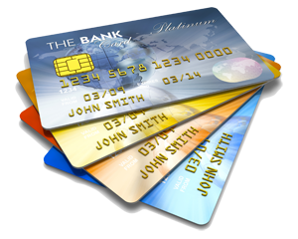
Types of Cards – Funding Perspective
Debit Cards – Buy Now and Pay Now
OTB is the balance you have in your savings account
During Auth Cycle, money is moved out of your account to escrow
During Settlement Cycle, payment is made from escrow
Credit Cards – Buy Now and Pay Later
OTB is Card Limit minus your purchase
During Auth Cycle, the OTB is reduced
During Settlement, the OTB reduction is locked
Prepaid Cards – Pay Now and Buy Later
Load the card and OTB is the amount in card
Balance reduce with purchase settlement
Most can be reloaded
Which is less risky?
For Merchant
For Card Holder
Notes:
There are so many type of cards, but essentially they can be classified as Debit, Credit and Prepaid
The types are based on time of funding and time of usage
Pay now buy now
Pay later buy now
Pay now buy later

Slide 21
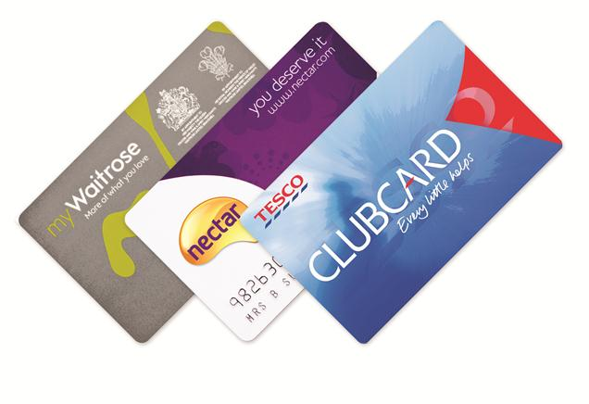
Types of Cards – Business Perspective
Corporate Card
For large corporate body, for each individual with defined limit
Business Card
Same as Corporate Card for smaller organization and the liability is on owner of the company
Purchase card
Merchant & limit specific (Store Card)
Loyalty Card
Promotional Reward Points
Notes:
Corporate cards are meant for large organization who want to provide their senior officials with cards with differentiated payment limits based on the requirements of the roles of the official
For smaller organization this differential payment is not provided, rather the entire amount extended to the organization may be extended to each of the officials and they need to be judicious in the way they limit their spending
Rest of the cards are for tracking the spending of the consumers in a store or extending loyalty for the purchase made in the store

Slide 22




Co Branded Cards
Citibank wants to launch in rural India
Walgreens wants to launch in urban India
Merchant
Bank
Bank
Merchant
Stronger bank claims the higher profit share
Notes:
It is about the strength of the brands
If Citi wants to launch a card in rural India, there would be not takers as the rural population does not recognize Citi brand but they do Post Office. Hence, Citi may want to co-brand with Post Office to penetrate the market. Here the bank is less known but merchant or service provider is well known
Similarly for the SBI – Walgreens, here the bank is well known and merchant is less known

Slide 23
Who pays whom – How ?
Past
Present
Future
Person-to-Person
Usually Cash
Person-to-Business
Usually Cash
Business-to-Person
Usually cheque
Business-to-Business
Usually cheque
Person-to-Person
Usually Cash
Person-to-Business
Card
Business-to-Person
Usually cheque
Business-to-Business
RTGS
Person-to-Person
Card / Mobile
Person-to-Business
Card / Mobile
Business-to-Person
Card / Mobile
Business-to-Business
RTGS

Slide 24
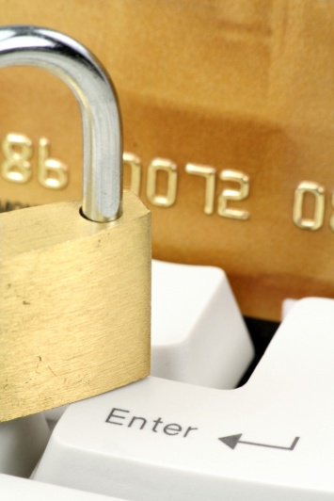
Unacceptable Risks are …
The Merchant is known to be a fraud
Merchants usual day limit has crossed 5 times over
The Terminal is suddenly firing large number of transactions
The Card is an expired card
The Card has been reported to be stolen
The Acquiring or Issuing Bank is bankrupt
The Card Holder purchased from India and 1 hour later purchased from UK
The Card Holder usually buys in range of Rs 2000, but suddenly there is a purchase is Rs 200,000 that too from a location she usually does not buy
… and many more …
To deal with this each Relationship boundary need to have Profiles pre computed
Issuer would know the buying pattern of card holder
Acquirer would know the merchant sell pattern terminal wise
Network would know authorization / settlement pattern of banks
Notes:
Now lets look at the unacceptable risks, some of which are listed here
The only way to deal with this is use monitors at every relationship boundaries to evaluate and trigger any discrepancies based on past payment behavior of the parties

Slide 25
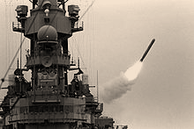
Relationship Model – Monitors
Business Monitors
Payment Network
Business Monitors
Even before the first missile was fired, Payment Network Monitors detected the war was imminent as huge cash withdrawal s were happening in Iraq
Card Issuing
Merchant Acquiring
My Card
We Accept
CH
Profile
Merchant
Profile
VALUE EXCHANGE
Trust needs to be Monitored against the Performance to protect Network Brand
Network Brand is the most important Trust parameters that enables Value Exchange
Notes:
This had resulted payment network in sensing extreme situations on ground which can put their brand at risk and they took corrective actions

Slide 26
Relationship Model – Monitors
Business Monitors
Payment Network
Business Monitors
Card Issuing
Merchant Acquiring
My Card
We Accept
CH
Profile
Merchant
Profile
VALUE EXCHANGE
Trust needs to be Monitored against the Performance to protect Network Brand
Network Brand is the most important Trust parameter that enables Value Exchange
Notes:
This had resulted payment network in sensing extreme situations on ground which can put their brand at risk and they took corrective actions

Slide 27
Risk and Fraud Management
Payment Network
Post Facto Risk Scoring (Offline)
Card Issuing
Merchant Acquiring
In flight Risk Scoring
(Online)
My Card
We Accept
Issuer may use it for authorization
Payment Activity
Fraud is largely perpetrated:
By own merchant
By cardholder, or fraud using stolen card
By Internal staff – fraud by the internal staff of the Card institute
Notes:
There are 2 types of risk monitoring – one during authorization (in-flight) and the other during settlement (batch)
During authorization, only a few data elements are used and a risk score is estimated which gets communicated to the issuer for them to take any action on it. As the time boundaries are stringent during authorization cycle, it acts as a “quick check”.
During settlement, larger number of data elements are used to score the risk as more time is available. If risk is high, the transaction is not passed to settlement but referred back to issuers for their review and approval.

Slide 28
Reliability and High Availability … 99.999%
Payment Network
Card Issuing
Merchant Acquiring
Stand In Processing
Positive Cardholder Auth Svc
Business Monitors
My Card
We Accept
Floor Limits
Brand Perception
Again the Brand Promise protection is provisioned by Reliability and High Availability
RED are for Business Continuity and BLUE for Resource Optimization
Notes:
As brand is the most important factor, and cardholder perception is extremely important, payment networks come up with various techniques to address the reliability and availability of their services.
If the Payment Network to Issuer link is down, Payment Networks provide stand-in services where they offer to maintain all the card holder payment position for the issuer and authorize on-behalf of the issuer and when links are restored, payment networks send the stand-in advices to issuer for updating their records.
There are services offered by payment networks called positive cardholder auth services where issuers can state that say if the amount is less than $30, payments network would authorize on issuers behalf even if the link is working – this is to reduce the load on the issuers IT systems.
Payment Networks run business monitors on the inputs that come from Acquirers. If a deviation is detected, payment network would call up acquirer and mention that “we are not seeing any transaction from you in last 5 min” – which can improve the overall availability factors.
Merchants are offered “floor limits” by acquirers – again to reduce system load – by stating that if the sale amount is less than $10, do not do the authorization, just pass it on the batch and it would be paid.
There is a fine balance between the risk and the return.

Slide 29
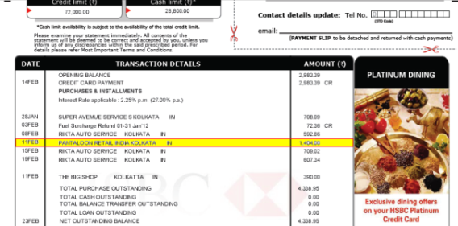
Errors & fraud still happen - Dispute Management
Payment Network
Card Issuing
Merchant Acquiring
Issuer tries to resolve after exchanging messages with Acquirer, through Request For Copy, Fulfillment, else fires Chargeback – money refunded to Cardholder, but process continues through Re-presentment, Pre-filing, Case Filing – in which case Payment Network gives verdict.
Case Filing costs are high (Visa = $75)
My Card
We Accept
Report to Issuer
Disagree with an entry in statement
Merchants have to furnish the Merchant Copy of slip signed by CH
Payment Activity
Cardholder is the weakest entity in the game – she needs to be protected as without her the system does not exist
Notes:
Whatever we do there would always be discrepancies. Cardholder finds a payment posting in the month end statement and may challenge that this is not something she has spent. This starts the dispute cycle. Cardholder informs Issuer. Issuer sends a request for copy of the slip from the merchant through Acquirer to verify the cardholder signature. And the cycle goes on whereby the incident is resolved between issuer and acquirer in either way. If the incident is not resolved, the case can be filed with payment network for a fee. The fee acts as a deterrent and reduce the number of cases.
If the issuer files a chargeback on behalf of the cardholder, the money is deducted from merchant and is paid to the cardholder – this is to protect the cardholder who is the weakest link in the chain. Later if the case goes in favor of merchant the money would be deducted from cardholder and paid to the merchant.

Slide 30
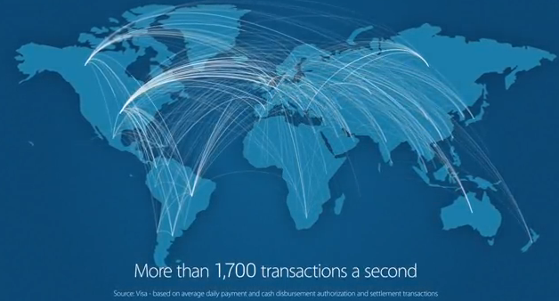

Analytics and Data Services
Payment Networks are sitting on a gold mine of data
Trends and spend-patterns are very valuable information
Performance and Fraud Analysis are possible
Socio Economic Analytics are possible
Source: http://www.youtube.com/watch?feature=player_embedded&v=FhqNy6maykE
Notes:
Payment networks are sitting on large amount of data which has huge potential for payment intelligence. Analytics are proving to be a new avenue for revenue generation by the payment networks.

Slide 31
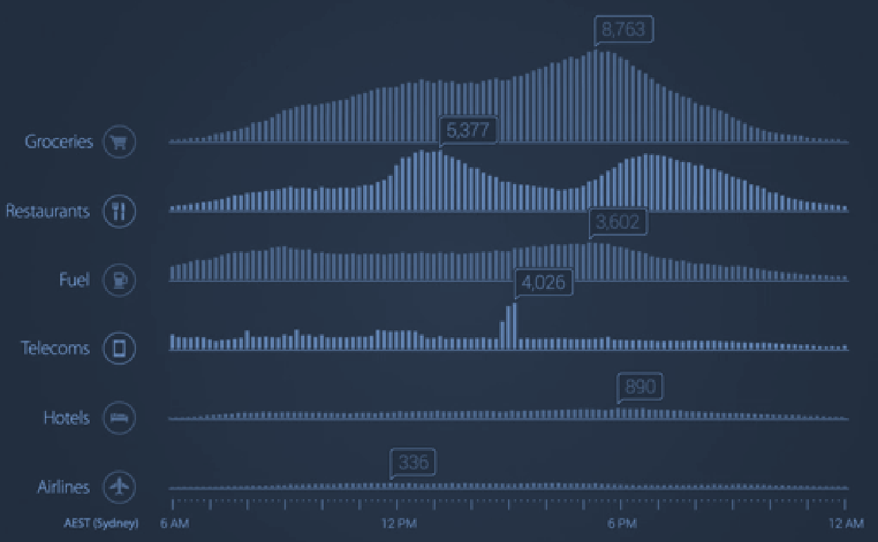
Analytics and Data Services : Spend Pattern
Visa @ Australia : 2014
Source: http://www.youtube.com/watch?feature=player_embedded&v=FhqNy6maykE

Slide 32
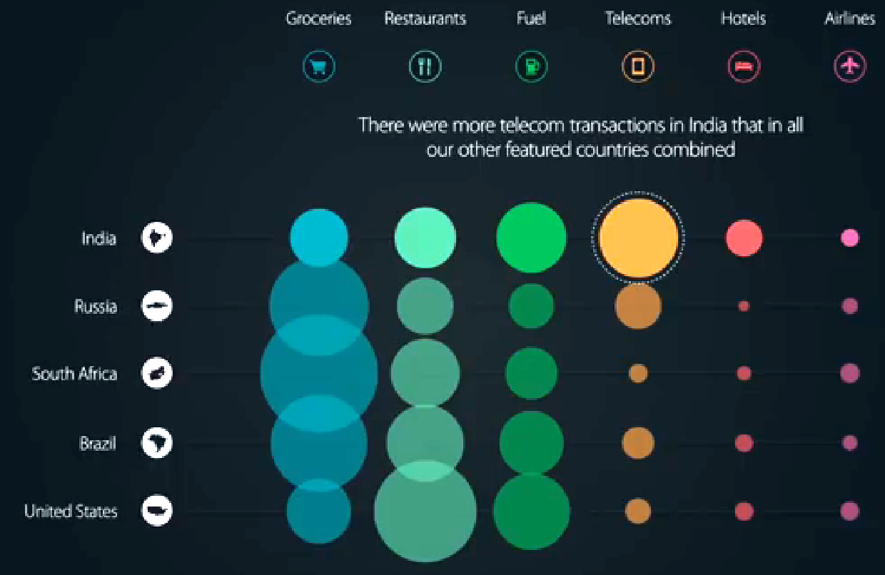
Analytics and Data Services : Spend Comparisons
Source: http://www.youtube.com/watch?feature=player_embedded&v=FhqNy6maykE

Slide 33
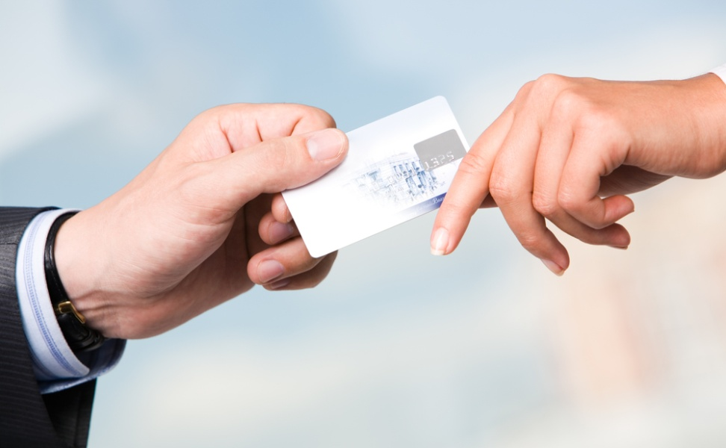
Recapitulation
Types of Cards
Types of Payment (From, To)
Risk Management
Brand Preservation – High Availability, Scalability
Dispute Management
Data Analytics
Notes:
This is recap of what has been covered in past session.

Slide 34
Payment Message
MTI
V N X Y
Message Type Identifier
V | ISO 8583 version number (0: 1987 1:1992 2:2003)
N | Message class (e.g. 1 Authorization 2 Financial 4 Reversal)
X | Message function.(e.g. 0 Request 1 Request response)
Y | Transaction originator (e.g. 0 Acquirer 1 Acquirer repeat 2 Issuer)
BITMAP
11010011
DE-01
<Value 01>
DE-02
<Value 02>
DE-04
<Value 04
Notes:
The payment message is the key for the electronic payments. The overall structure is as presented. The attempt is to have as compact information as possible so that the bandwidth is optimally used.
It would be good to go to Wikipedia and look up the data elements of ISO 8583

Slide 35
ISO 8583: Important Fields
What and When
PAN, Expiry, PIN/CVV2/CVC/VBV/SC/OTP – Identification, Authentication and Validation
Date/Time
Is this a repeat transaction because the first time it did not work, or was is a second transaction of same amount from same store
Where
Brick and mortar / Which shop
Virtual Store
What was the type of the merchant (Retail Shop/Gas Station/Casino)
How
What was the capability of the POS (PIN/NFC/Reader)
How the information was captured (Swipe/Keyed/Proximity)
If it was card present scenario, was the Binary data captured

Slide 36
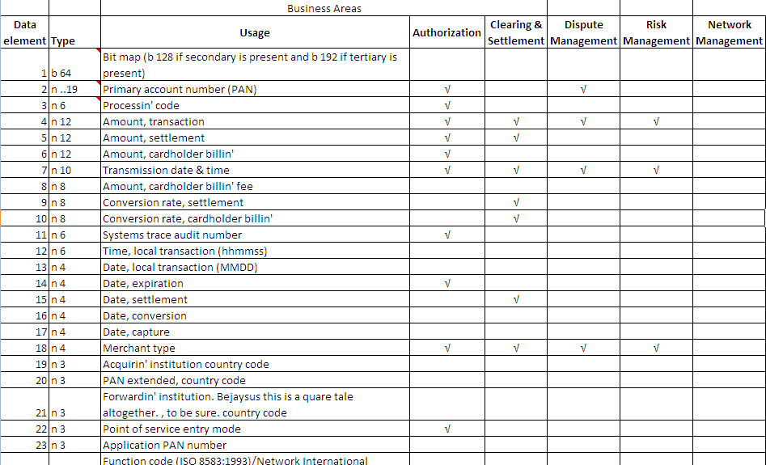
Some of the fields

Slide 37
IT System Requirements of Stakeholders
Payment Network
Card Issuing
Merchant Acquiring
• Network
• Authorization
• Fraud
• Settlement
• Dispute
• Business Monitor
Customer Acquiring System
Card Issuance
Customer Relationship Management
Card Holder Billing
Collection & Tracking System
Credits System – Interest calculation
Marketing Tool – New Product Design etc
Dispute Automation System
POS Device / Card Payment Acceptance Device
Co-Branded / Store Card etc
Integration of Inventory System of Merchant
E-Commerce Site for merchants
Reward Scheme
Promotional Scheme
Notes:
The slide provides the main IT systems that constitutes the Payment Network, Issuers and Acquirers
Our work would generally touch some of these IT systems
As payment system emerge new IT system would get added

Slide 38
EMV
Micro Payments
Virtual Receipts
Mobile Payments
In Country Settlement
Cloud
NFC
Thank You
Closed Loop
Wallet
Location Aware
Digital Currency
Targeted Promotions
Customer Profile

Slide 39
Change History
# | Location | Description | Author | Reviewer | Date
1 | All | Initial draft | Sumit |  | April 4, 2012
2 | Slide Data Analytics | Changed Data Analytics | Sumit |  | March 5, 2014
3 | Look & Feel | Changed images |  | Soma | April 11, 2014

